Slide 1
Data Clustering (Contd)
CS771: Introduction to Machine Learning
Piyush Rai

Slide 2
Plan
K-means extensions
Soft clustering
Kernel K-means
A few other popular clustering algorithms
Hierarchical Clustering
Agglomerative Clustering
Divisive Clustering
Graph Clustering
Spectral Clustering
Density-based clustering
DBSCAN
Basic idea of probabilistic clustering methods, such as Gaussian mixture models (details when we talk about latent variable models)

Slide 3
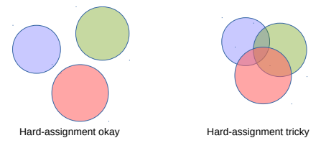



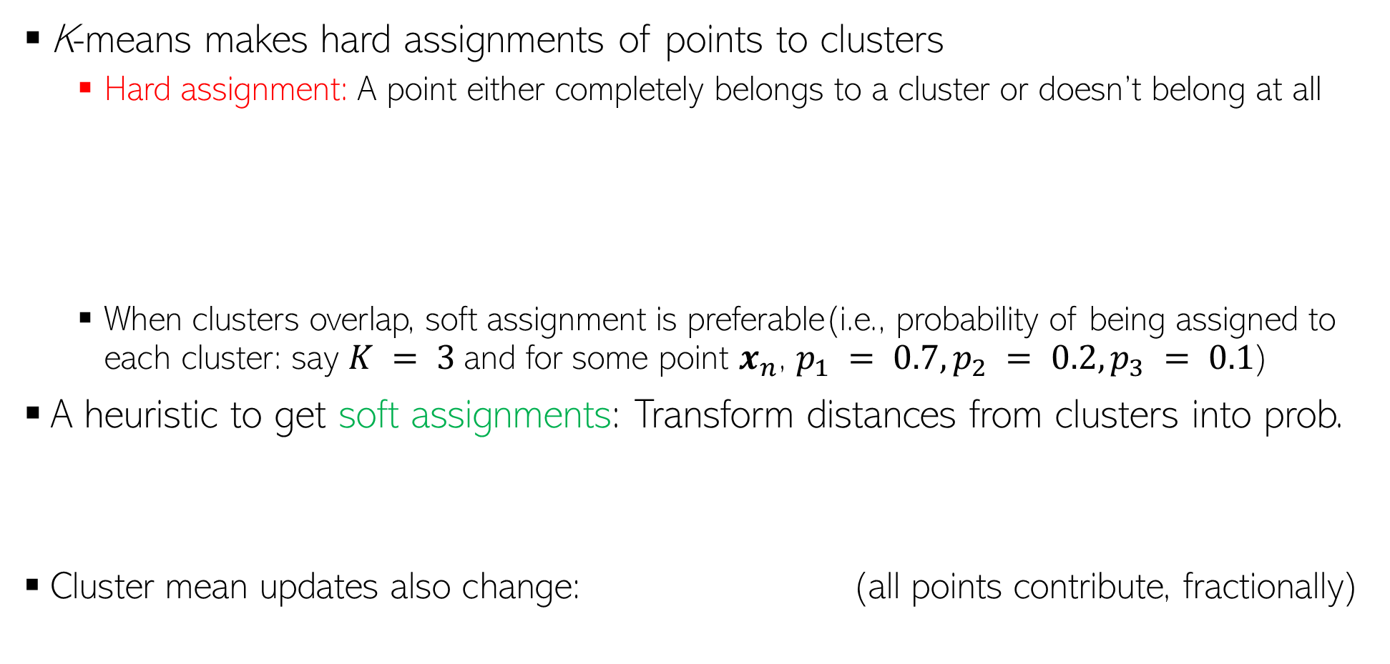
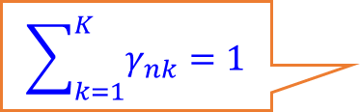
K-means: Hard vs Soft Clustering
K-means makes hard assignments of points to clusters
Hard assignment: A point either completely belongs to a cluster or doesn’t belong at all
When clusters overlap, soft assignment is preferable(i.e., probability of being assigned to each cluster: say $K = 3$and for some point $x_{n}$, $p_{1} = 0.7, p_{2} = 0.2, p_{3} = 0.1$)
A heuristic to get soft assignments: Transform distances from clusters into prob.
Cluster mean updates also change: (all points contribute, fractionally)
A more principled extension of K-means for doing soft-clustering is via probabilistic mixture models such as the Gaussian Mixture Model
$$\sum_{k=1}^{K}{γ_{nk}=1}$$

Slide 4
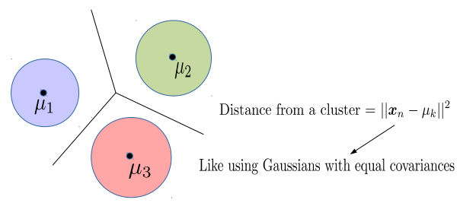
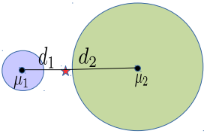
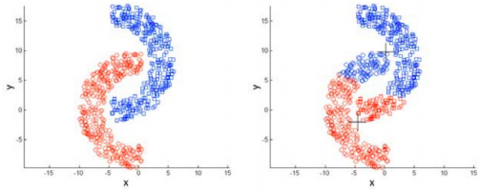
K-means: Decision Boundaries and Cluster Sizes/Shapes
K-mean assumes that the decision boundary between any two clusters is linear
Reason: The K-means loss function implies assumes equal-sized, spherical clusters
May do badly if clusters are not roughly equi-sized and convex-shaped
Reason: Use of Euclidean distances

Slide 5
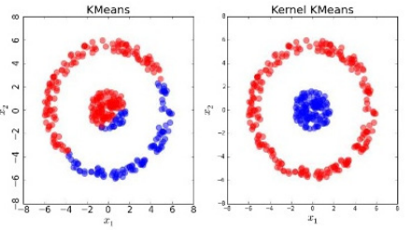
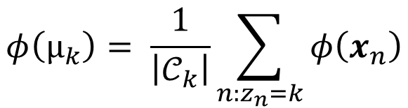

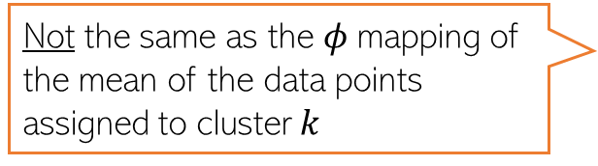
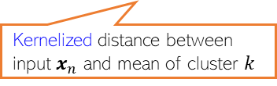
Kernel K-means
Helps learn non-spherical clusters and nonlinear cluster boundaries
Basic idea: Replace the Eucl. distances in K-means by the kernelized versions
Here $k(., .)$denotes the kernel function and $φ$ is its (implicit) feature map
Note: $φ(μ_{k})$ is the mean of $φ$ mappings of the data points assigned to cluster $k$
Kernelized distance between input $x_{n}$ and mean of cluster $k$
Not the same as the $φ$mapping of the mean of the data points assigned to cluster $k$
$$φ\left(μ_{k}\right)= \frac{1}{\left|𝒞_{k}\right|}\sum_{n:z_{n}=k}{φ\left(x_{n}\right)}$$
Can also used landmarks or kernel random features idea to get new features and run standard k-means on those
Note: Apart from kernels, it is also possible to use other distance functions in K-means. Bregman Divergence* is such a family of distances (Euclidean and Mahalanobis are special cases)
*Clustering with Bregman Divergences (Banerjee et al, 2005)

Slide 6
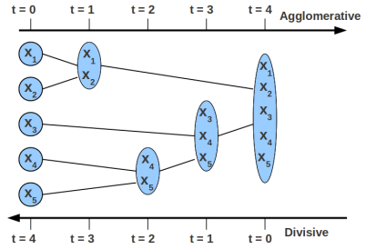
Hierarchical Clustering
Similarity between two clusters (or two set of points) is needed in HC algos (e.g., this can be average pairwise similarity between the inputs in the two clusters)
Can be done in two ways: Agglomerative or Divisive
Agglomerative is more popular and simpler than divisive (the latter usually needs complicated heuristics to decide cluster splitting).
Neither uses any loss function
Agglomerative: Start with each point being in a singleton cluster
Keep recursing until the desired number of clusters found
At each step, greedily merge two most “similar” sub-clusters
At each step, break a cluster into (at least) two smaller homogeneous sub-clusters
Stop when there is a single cluster containing all the points
Divisive: Start with all points being in a single cluster
Learns a dendrogram-like structure with inputs at the leaf nodes. Can then choose how many clusters we want
Tricky because no labels (unlike Decision Trees)

Slide 7
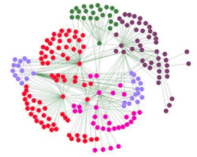
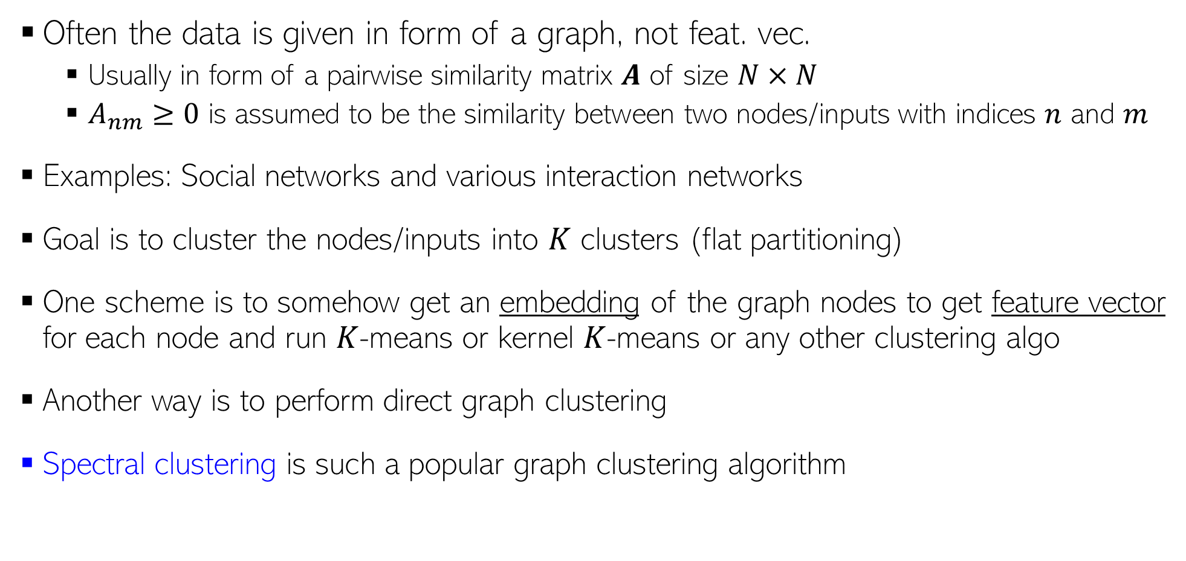
Graph Clustering
Lot of recent work on learning node embeddings for graphs (e.g., node2vec and other related methods)
Often the data is given in form of a graph, not feat. vec.
Usually in form of a pairwise similarity matrix $A$ of size $N×N$
$A_{nm}≥0$ is assumed to be the similarity between two nodes/inputs with indices $n$ and $m$
Examples: Social networks and various interaction networks
Goal is to cluster the nodes/inputs into $K$ clusters (flat partitioning)
One scheme is to somehow get an embedding of the graph nodes to get feature vector for each node and run $K$-means or kernel $K$-means or any other clustering algo
Another way is to perform direct graph clustering
Spectral clustering is such a popular graph clustering algorithm
Various graph embedding algorithms exist (e.g., node2vec)

Slide 8

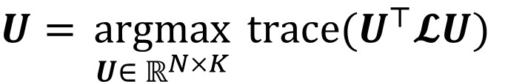
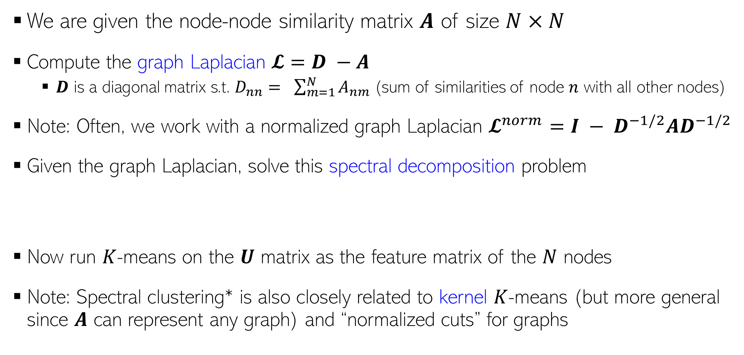
Spectral Clustering
Spectral clustering has a beautiful theory behind it (won’t get into it in this course; may refer to a very nice tutorial article listed below, if interested)
We are given the node-node similarity matrix $A$ of size $N×N$
Compute the graph Laplacian $𝓛=D −A$
$D$ is a diagonal matrix s.t. $D_{nn}= \sum_{m=1}^{N}{A_{nm}}$(sum of similarities of node $n$ with all other nodes)
Note: Often, we work with a normalized graph Laplacian $𝓛^{norm}={I − D}^{−1/2}AD^{−1/2}$
Given the graph Laplacian, solve this spectral decomposition problem
Now run $K$-means on the $U$ matrix as the feature matrix of the $N$ nodes
Note: Spectral clustering* is also closely related to kernel $K$-means (but more general since $A$ can represent any graph) and “normalized cuts” for graphs
Meaning U has orthonormal columns
$U=\underset{ U∈ ℝ^{N×K} }{argmax} trace(U^{⊤}𝓛U)$
$$s.t. U^{⊤}U=I$$
*Kernel k-means, Spectral Clustering and Normalized Cuts (Dhillon et al, 2004)
A Tutorial on Spectral Clustering (Ulrike von Luxburg, 2007)

Slide 9
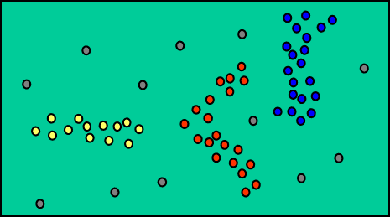
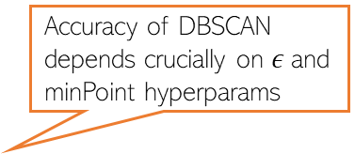
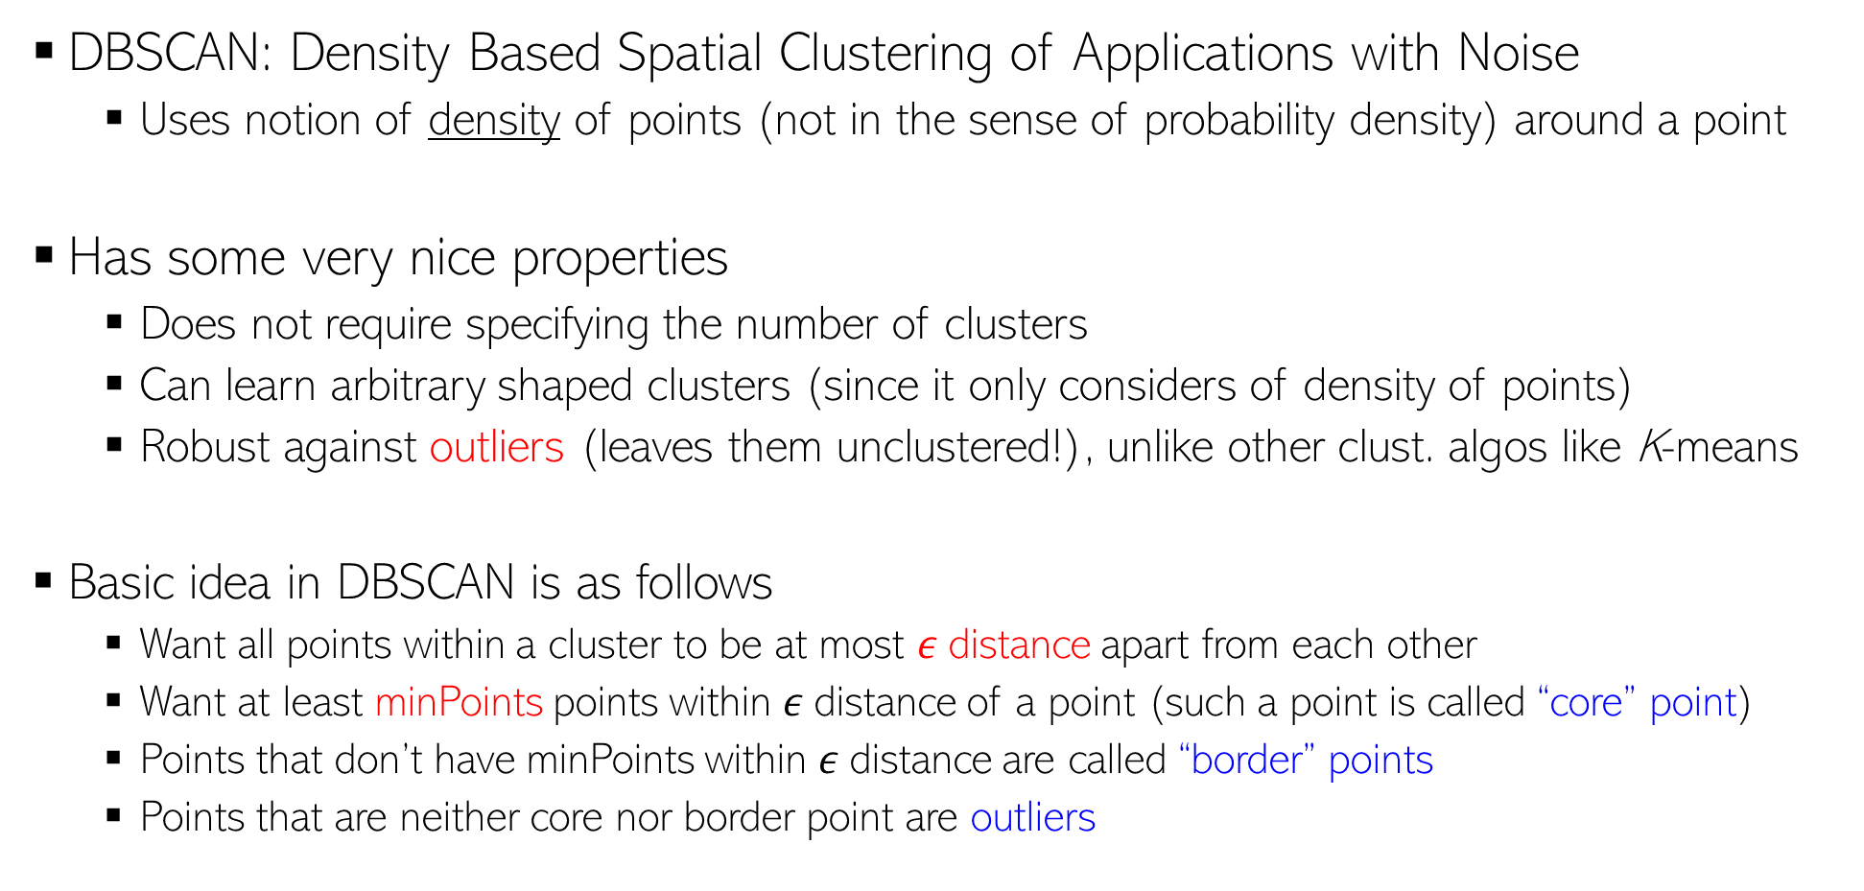
Density based Clustering - DBSCAN
DBSCAN: Density Based Spatial Clustering of Applications with Noise
Uses notion of density of points (not in the sense of probability density) around a point
Has some very nice properties
Does not require specifying the number of clusters
Can learn arbitrary shaped clusters (since it only considers of density of points)
Robust against outliers (leaves them unclustered!), unlike other clust. algos like K-means
Basic idea in DBSCAN is as follows
Want all points within a cluster to be at most $ε$distance apart from each other
Want at least minPoints points within $ε$distance of a point (such a point is called “core” point)
Points that don’t have minPoints within $ε$distance are called “border” points
Points that are neither core nor border point are outliers
DBSCAN treats densely connected points as a cluster, regardless of the shape of the cluster
Grey points left unclustered since they are most likely outliers
Accuracy of DBSCAN depends crucially on $ε$and minPoint hyperparams

Slide 10
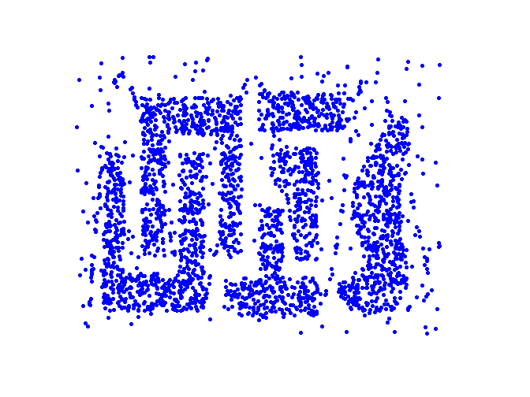
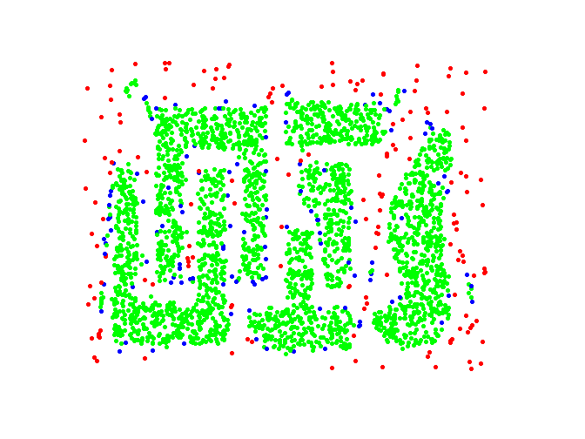

DBSCAN (Contd)
The animation on the right shows DBSCAN in action
The basic algorithm is as follows
A point is chosen at random
If more than minPoint neighbors $≤ε$ distance, then call it core point
Check if more points fall within $ε$ distance of core/its neighbors
If yes, include them too in the same cluster
Once done with this cluster, pick another point randomly and repeat
An example of clustering obtained by DBSCAN
Green points are core points, blue points are border points, red points are outliers
DBSCAN is mostly a heuristic based algorithm. No loss function unlike K-means
Animation credit: https://dashee87.github.io/

Slide 11


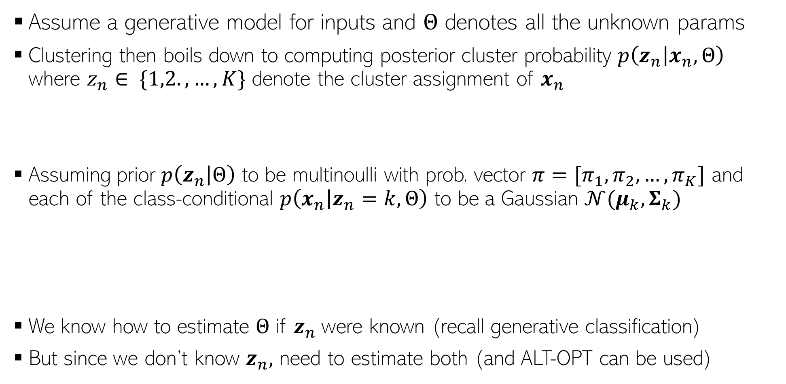
Going the Probabilistic Way..
Assume a generative model for inputs and $Θ$ denotes all the unknown params
Clustering then boils down to computing posterior cluster probability $p\left(z_{n} | x_{n},Θ\right)$ where $z_{n}∈ \{1,2.,…,K\}$ denote the cluster assignment of $x_{n}$
Assuming prior $p\left(z_{n} | Θ\right)$ to be multinoulli with prob. vector $π=[π_{1},π_{2},…, π_{K}]$ and each of the class-conditional $p\left(x_{n} | z_{n}=k,Θ\right)$ to be a Gaussian $𝒩(μ_{k}, Σ_{k})$
We know how to estimate $Θ$ if $z_{n}$were known (recall generative classification)
But since we don’t know $z_{n},$ need to estimate both (and ALT-OPT can be used)
(from Bayes rule)
$p\left(z_{n}=k | x_{n},Θ\right)∝π_{k}×$ $𝒩\left(x_{n}\right|μ_{k}, Σ_{k})$
(Here $Θ={\{π_{k},μ_{k},Σ_{k}\}}_{k=1}^{K}$)
Posterior prob. Of cluster assignment also depends on prior probability (fraction of points in that cluster if using MLE)
Different clusters can have different covariances (hence different shapes)
Just like in K-means

Slide 12
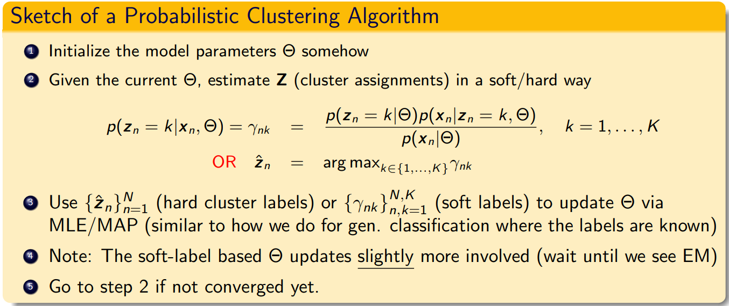
Going the Probabilistic Way..
At a high-level, a probabilistic clustering algorithm would look somewhat like this
The above algorithm is an instance of a more general Expectation Maximization (EM) algorithm for latent variable models (we will see this soon)
Akin to initializing the cluster means in K-means
Akin to computing cluster assignments in K-means
Akin to updating cluster means in K-means

Slide 13
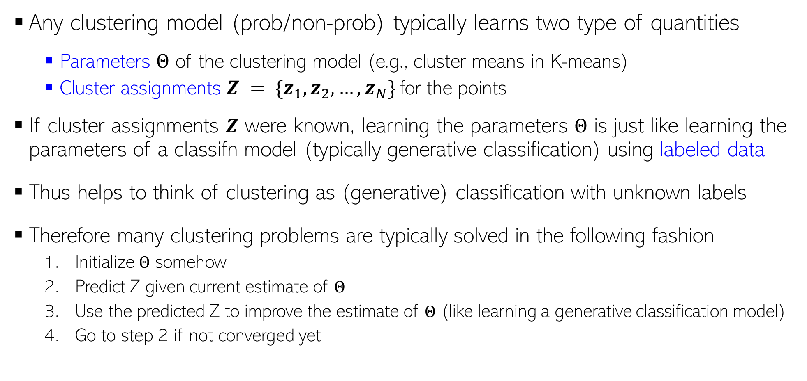
Clustering vs Classification
Any clustering model (prob/non-prob) typically learns two type of quantities
Parameters $Θ$ of the clustering model (e.g., cluster means in K-means)
Cluster assignments $Z = \{z_{1}, z_{2}, …, z_{N}\}$for the points
If cluster assignments $Z$ were known, learning the parameters $Θ$ is just like learning the parameters of a classifn model (typically generative classification) using labeled data
Thus helps to think of clustering as (generative) classification with unknown labels
Therefore many clustering problems are typically solved in the following fashion
Initialize $Θ$ somehow
Predict Z given current estimate of $Θ$
Use the predicted Z to improve the estimate of $Θ$ (like learning a generative classification model)
Go to step 2 if not converged yet

Slide 14
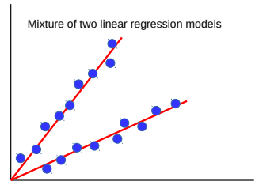
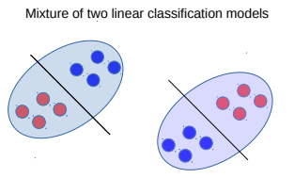
Clustering can help supervised learning, too
Often “difficult” sup. learning problems can be seen as mixture of simpler models
Example: Nonlinear regression or nonlinear classification as mixture of linear models
Don’t know which point should be modeled by which linear model ⇒ Clustering
Can therefore solve such problems as follows
Initialize each linear model somehow (maybe randomly)
Cluster the data by assigning each point to its “closest” linear model (one that gives lower error)
(Re-)Learn a linear model for each cluster’s data. Go to step 2 if not converged.
Such an approach is also an example of divide and conquer and is also known as “mixture of experts” (will see it more formally when we discuss latent variable models)

Slide 15
Coming up next
Latent Variable Models
Mixture models using latent variables
Expectation Maximization algorithm

